Slide 1
DATA VISUALIZATION OF BIRD STRIKES By: Rohan Palkar

Slide 2
Problem statement
Transport and communication are in the crucial domain in the field of analytics. Environmental impacts and safety are, nowadays, two major concerns of the scientific community with respect to transport scenarios and to the ever-growing urban areas. These issues gain more importance due to the increasing amount of vehicles and people. A bird strike is strictly defined as a collision between a bird and an aircraft which is in flight or on a take-off or landing roll. Bird Strike is common and can be a significant threat to aircraft safety. To have a closer look the following document visually depicts the data collected on Bird Strikes by FAA between 2000-2011.
29/01/2023
TITLE: DATA VISUALIZATION OF BIRD STRIKES

Slide 3
Collection OF Dataset
This is a Sales related dataset that contains Information like Phase of flight, Precipitation, Cost: Total, Pilot warned of birds or wildlife, Number of people injured, Feet above ground, Flight Date, Impact to flight etc.
29/01/2023
TITLE: DATA VISUALIZATION OF BIRD STRIKES

Slide 4
Architecture Design
Raw Data Collection
Import libraries in Jupyter
Load Dataset
Finding missing values
Deployment
Architecture Document
Project Report
Handling Outliers
Data pre processing
Load Dataset
Dashboard Design
Power bi Desktop
Data Analysis
Data Cleaning
29/01/2023
TITLE: DATA VISUALIZATION OF BIRD STRIKES

Slide 5
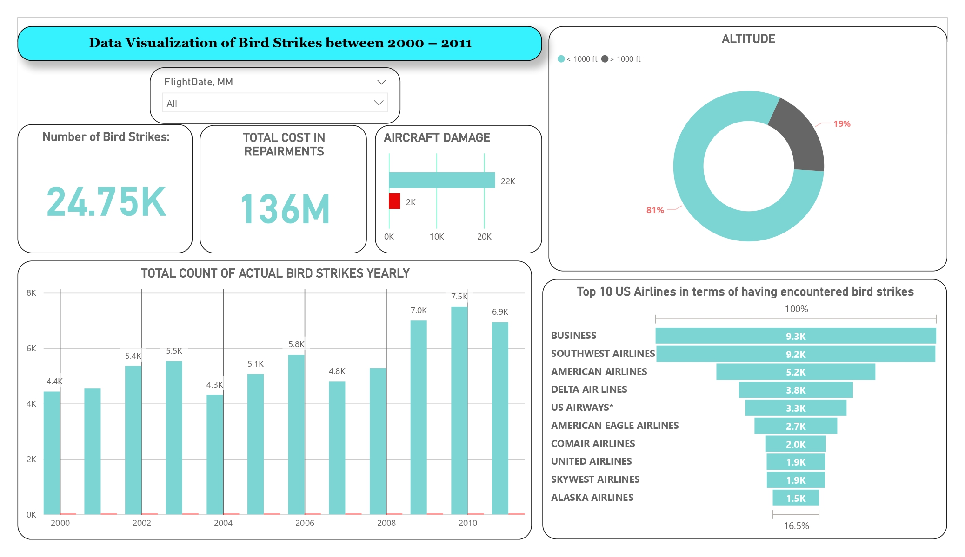
Dashboard
29/01/2023
TITLE: DATA VISUALIZATION OF BIRD STRIKES

Slide 6
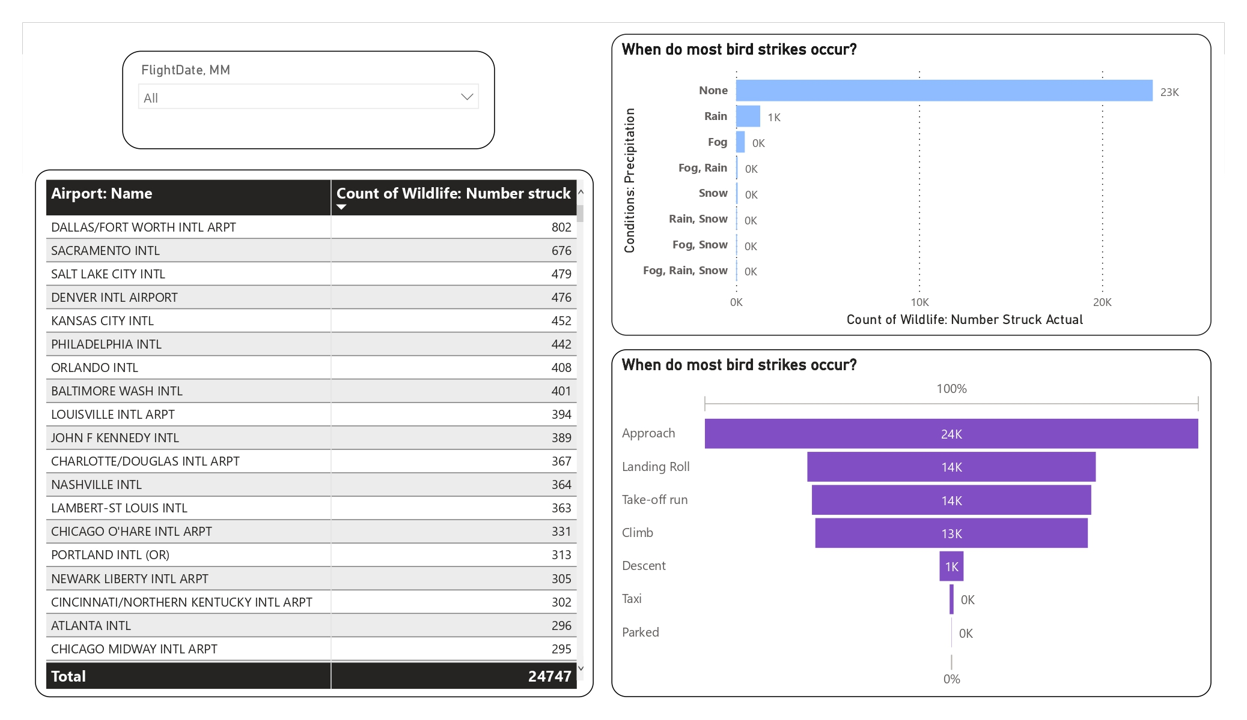
29/01/2023
TITLE: DATA VISUALIZATION OF BIRD STRIKES

Slide 7
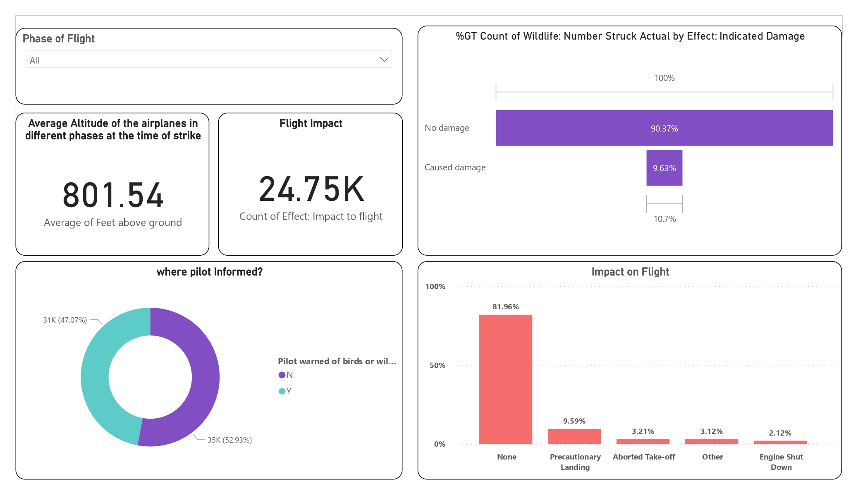
29/01/2023
TITLE: DATA VISUALIZATION OF BIRD STRIKES

Slide 8
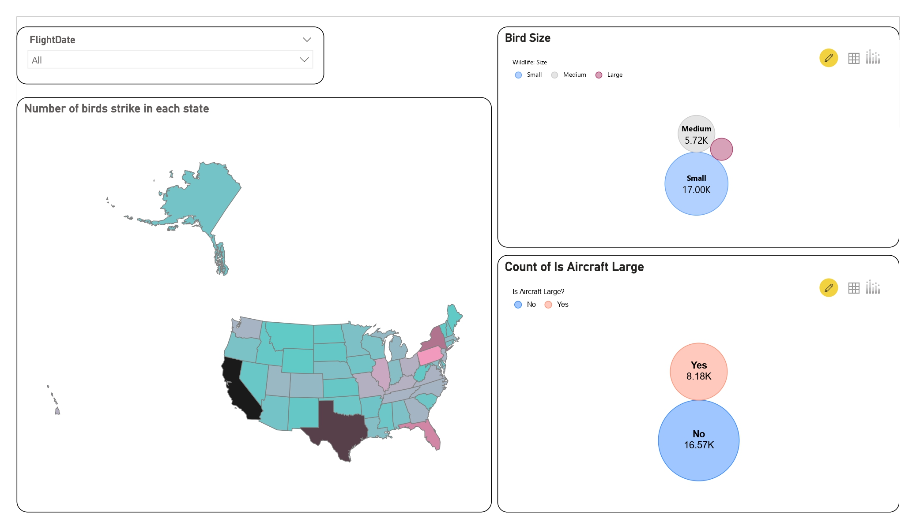
29/01/2023
TITLE: DATA VISUALIZATION OF BIRD STRIKES

Slide 9
Thank You

